Slide 1






Borcelle
Home
About Us
Documentation
Contact
THE HARMONY
OF NATURE
Preserving Ecosystem Balance for the Future

Slide 2


Borcelle
Home
About Us
Documentation
Contact
INTRODUCTION
Understanding the Balance of Nature
Nature is a vast, interconnected system where every element plays a crucial role in maintaining balance. From lush forests to flowing rivers, each component sustains life. This presentation explores how ecosystems work together, the role of flora and fauna, human impact, and conservation efforts. Understanding nature’s harmony helps us protect and preserve our planet’s delicate balance for future generations.

Slide 3


Borcelle
Home
About Us
Documentation
Contact
How everything in nature is connected
THE INTERCONNECTEDNESS OF NATURE
Ecosystem Balance
Each species, from predators to pollinators, plays a vital role in keeping ecosystems stable. Removing one element can disrupt the entire system, causing imbalance.
Nutrient Cycles
Nature’s cycles, such as carbon, nitrogen, and water cycles, ensure life’s sustainability. These processes recycle essential nutrients, maintaining ecological balance across various environments.

Slide 4
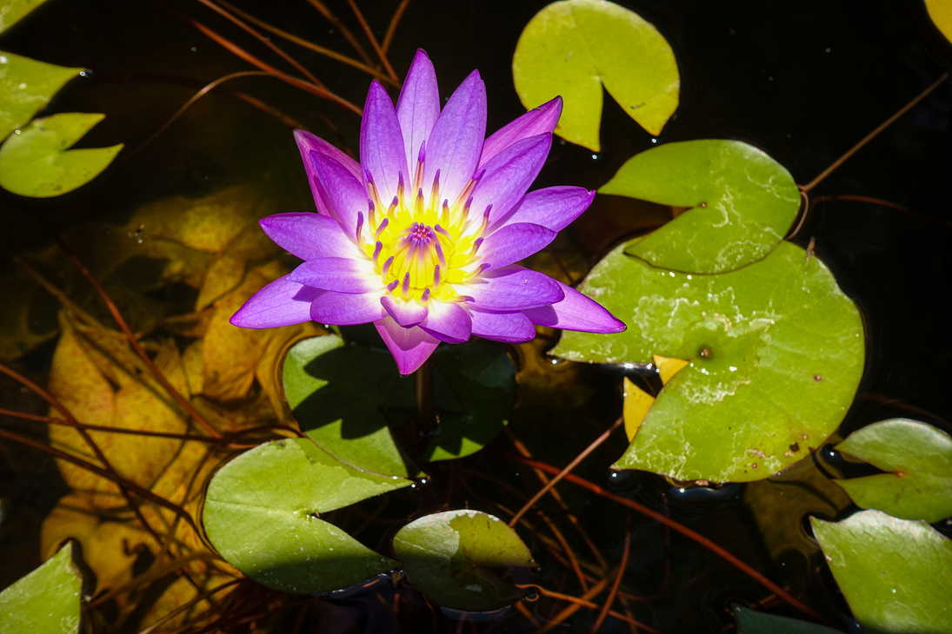
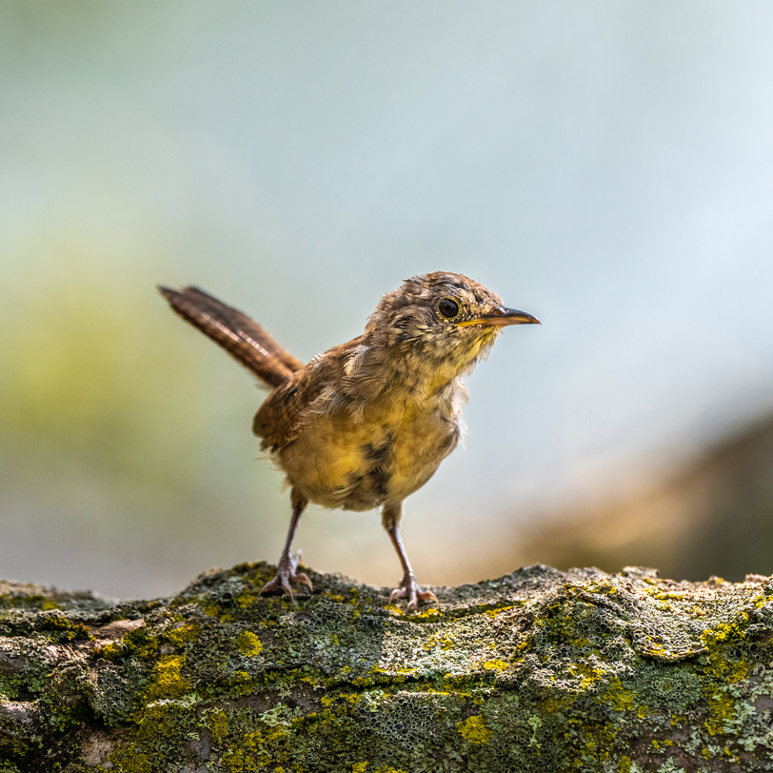
Borcelle
Home
About Us
Documentation
Contact
Flora’s Role
Fauna’s Role
Animals support biodiversity by controlling populations, pollinating plants, and dispersing seeds. Their interactions maintain ecological stability, ensuring that different species thrive in harmony within their environments.
Plants are the foundation of ecosystems, providing oxygen, food, and shelter. They stabilize soil, regulate climate, and contribute to the water cycle, making life possible.
THE ROLE OF FLORA AND FAUNA

Slide 5
Borcelle
Home
About Us
Documentation
Contact
Life Sustainer
Habitat Provider
Climate Regulator
Nutrient Transporter
Water is essential for all living organisms, supporting hydration, metabolism, and survival in every ecosystem, from forests to deserts.
Rivers, lakes, and oceans serve as habitats for countless species, offering breeding grounds and food sources for aquatic and terrestrial life.
Water influences weather patterns, cools the environment, and maintains temperature stability, ensuring optimal conditions for plants and animals.
Water distributes essential nutrients across ecosystems, supporting plant growth and sustaining food chains by providing resources to various organisms.
THE VITAL ROLE OF WATER IN ECOSYSTEMS

Slide 6
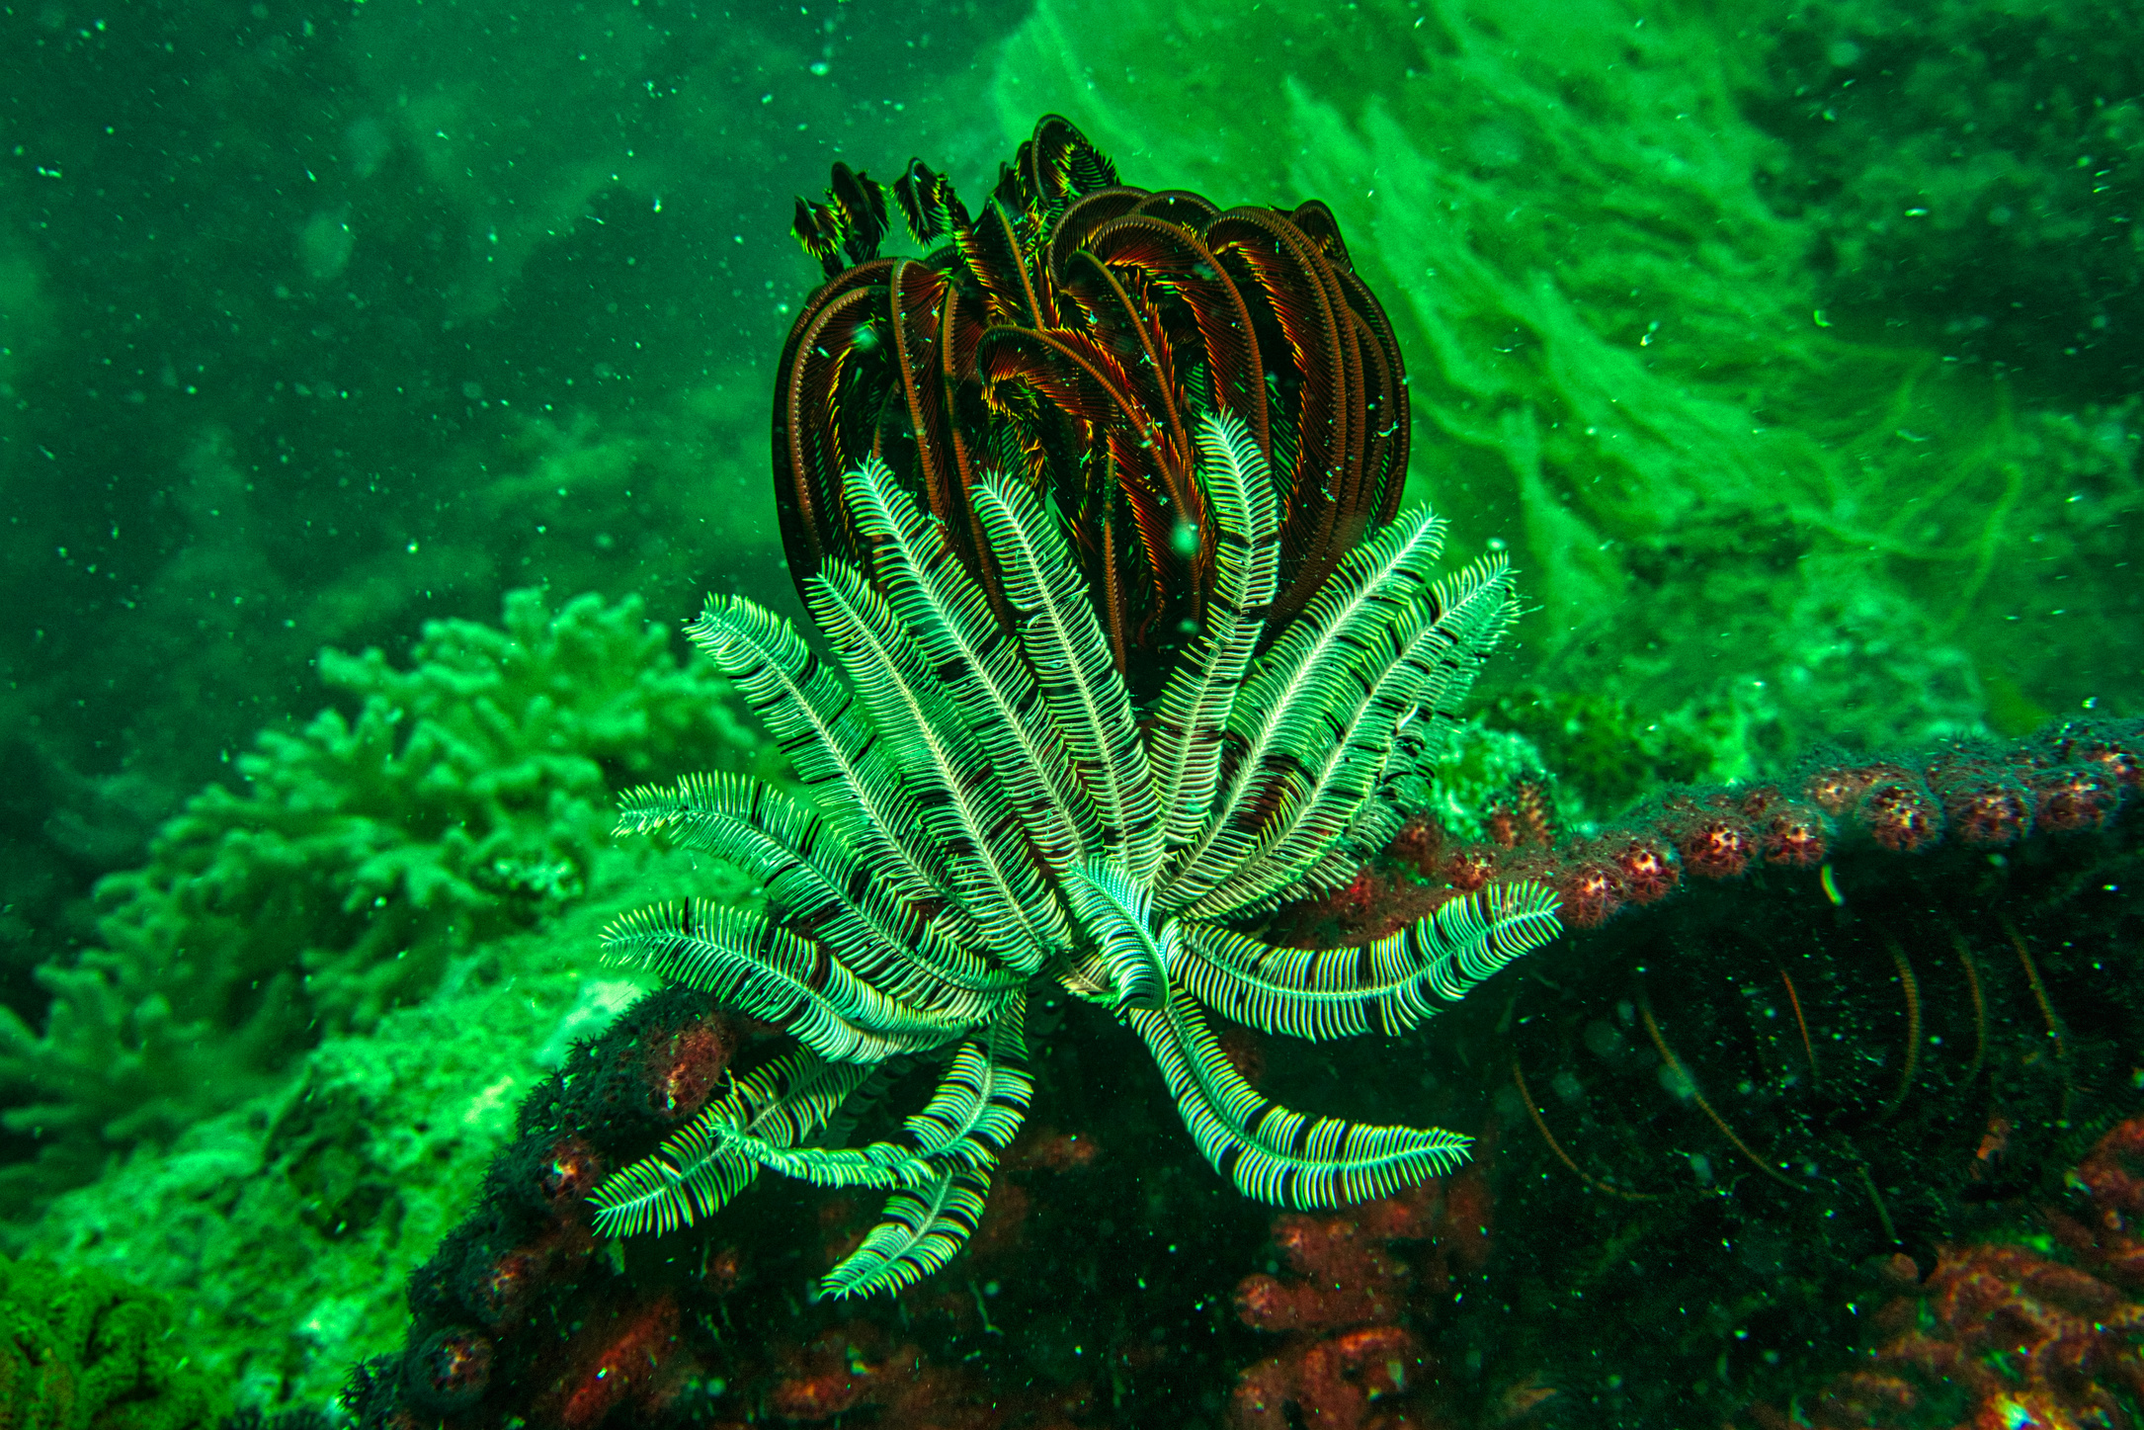
Borcelle
Home
About Us
Documentation
Contact
CLIMATE AND WEATHER PATTERNS
Nature’s Climate Connection
Climate’s Influence
Climate determines ecosystems' characteristics, from rainforests to arid deserts. Changes in temperature, precipitation, and seasonal patterns impact biodiversity and ecosystem health worldwide.
Weather’s Role
Weather fluctuations affect migration, plant growth, and survival rates. Storms, droughts, and temperature shifts influence the delicate balance within nature’s intricate web of life.

Slide 7
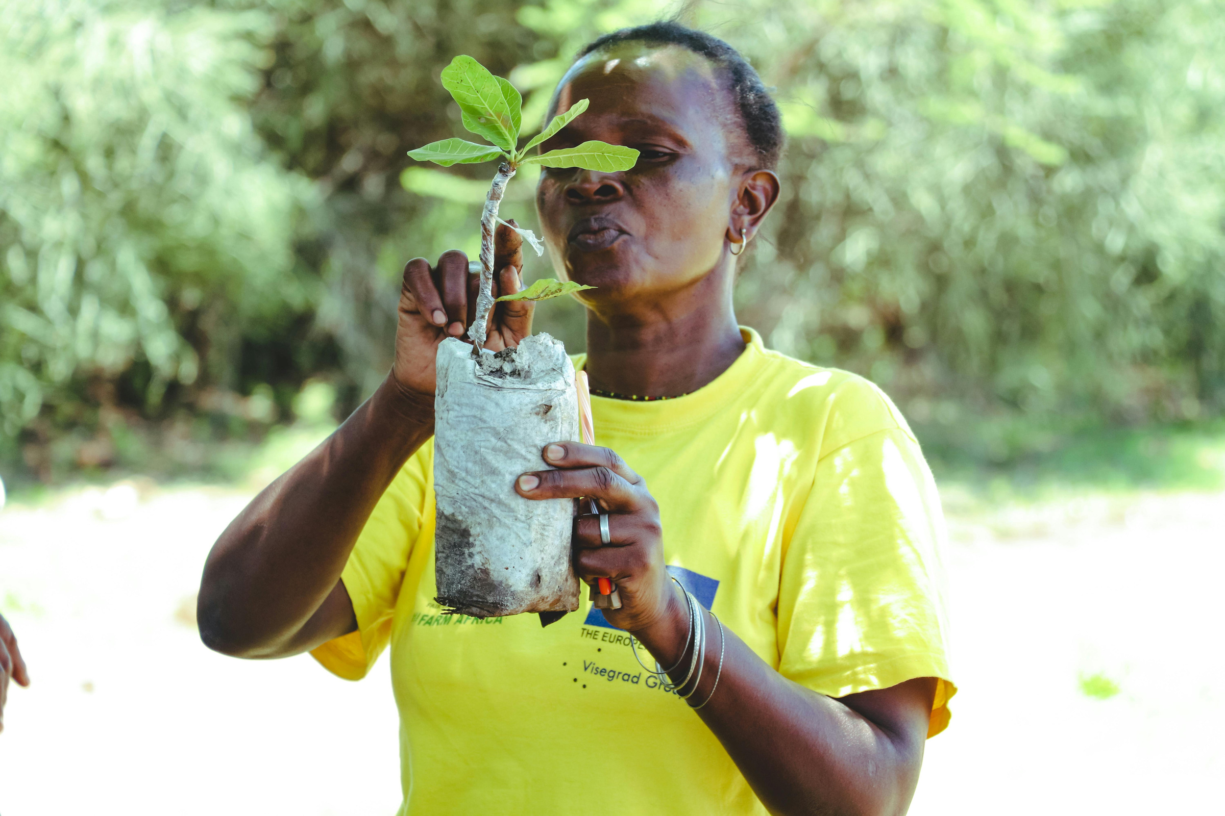
Borcelle
Home
About Us
Documentation
Contact
HUMANS AS PART OF NATURE
Despite technological advancements, humans remain part of Earth’s intricate ecosystem. Industrialization and urbanization have altered landscapes, but conservation efforts can mitigate damage. By preserving forests, protecting wildlife, and reducing pollution, we ensure that future generations inherit a world where nature and humanity coexist in harmony.
Humans are deeply connected to nature, relying on its resources for survival. We depend on forests for oxygen, rivers for water, and biodiversity for food. Our actions shape ecosystems, influencing climate, wildlife populations, and environmental health. Sustainable living and responsible resource management help maintain nature’s delicate balance.

Slide 8
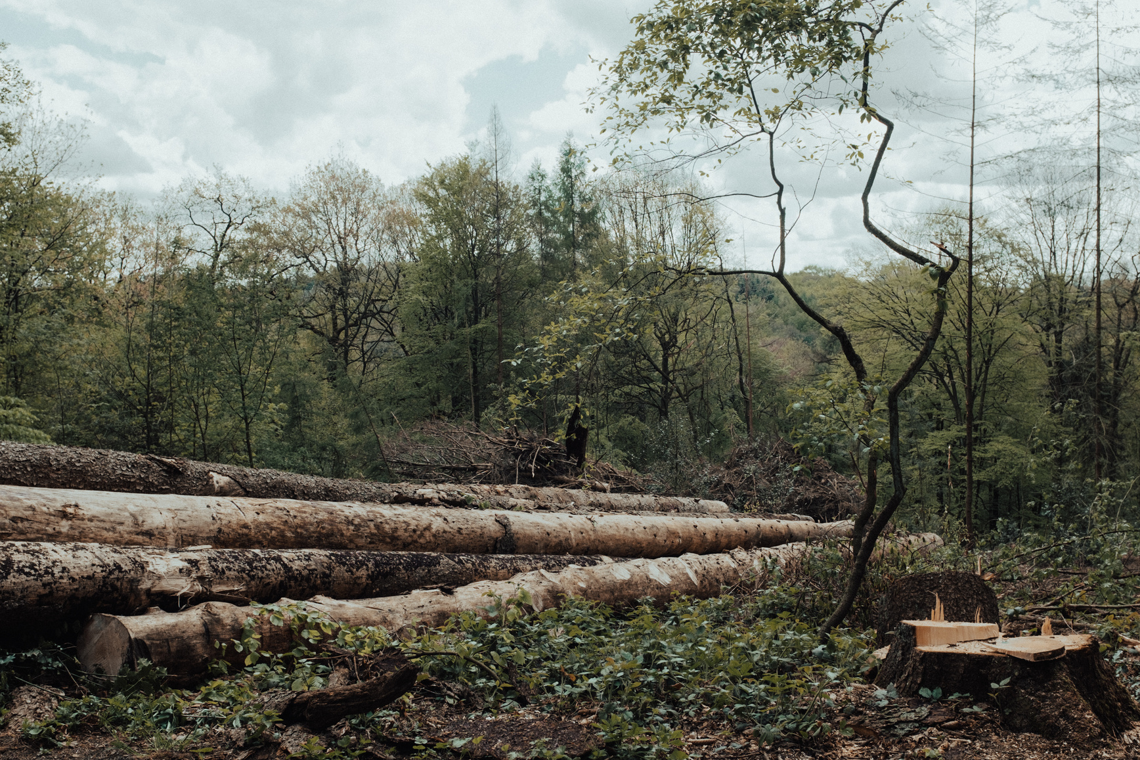
Borcelle
Home
About Us
Documentation
Contact
Deforestation
Pollution
Large-scale tree removal disrupts ecosystems, reduces biodiversity, and contributes to climate change by decreasing carbon absorption and altering habitats.
Air, water, and soil pollution harm wildlife, poison ecosystems, and degrade natural resources essential for survival.
THREATS TO NATURE’S HARMONY
Climate Change
Overexploitation
Rising temperatures, extreme weather, and melting ice caps threaten ecosystems, causing habitat loss and endangering species worldwide.
Excessive hunting, fishing, and resource extraction deplete nature’s reserves, endangering species and disturbing ecological stability.

Slide 9

Borcelle
Home
About Us
Documentation
Contact
Habitat Protection
Preserving forests, wetlands, and oceans ensures biodiversity thrives. Protected areas, like national parks, safeguard species and ecosystems from human-induced harm.
Sustainable Practices
CONSERVATION EFFORTS
Eco-friendly agriculture, responsible fishing, and renewable energy reduce environmental impact, promoting long-term balance between nature and human needs.

Slide 10


Borcelle
Home
About Us
Documentation
Contact
TRADITIONAL WISDOM AND NATURE
Lessons from the Past
Indigenous cultures have long understood the harmony between humans and nature. Their sustainable practices, such as rotational farming, controlled burning, and wildlife conservation, promote balance without depleting resources. Traditional ecological knowledge emphasizes respect for nature, ensuring resources remain available for future generations. By integrating ancestral wisdom with modern science, we can foster a more sustainable world.

Slide 11

Borcelle
Home
About Us
Documentation
Contact
Innovations and solutions for a balanced world
FUTURE OF NATURE’S HARMONY
Renewable Energy Expansion
Reforestation and Land Restoration
Community Involvement
Shifting towards solar, wind, and hydropower reduces reliance on fossil fuels, minimizing pollution and combating climate change for a sustainable future.
Planting trees and rehabilitating degraded lands restore biodiversity, regulate climate, and combat desertification, ensuring ecosystem resilience.
Education, activism, and sustainable policies empower individuals to take action, fostering a global movement for environmental protection and ecological restoration.

Slide 12
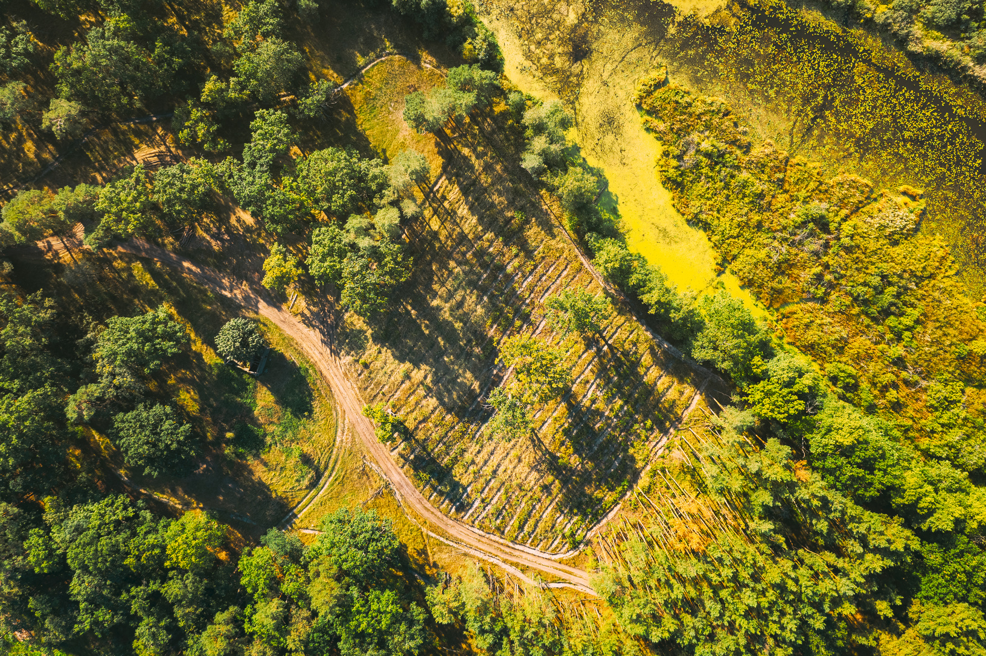





Borcelle
Home
About Us
Documentation
Contact
THANK YOU
+123-456-7890
Get In Touch
WWW.REALLYGREATSITE.COM
HELLO@REALLYGREATSITE.COM
123 ANYWHERE ST., ANY CITY, ST 12345

